Slide 1
A Web Application on Forecasting the Bitcoin Prices of Next day using ML
Presenting by :
Md Iftekhar Hossain Tushar
B.Sc (engineering) in CSE
Level : 4 Semester : II
Student ID : 1902061
Azizur Rahman Maruf
B.Sc (engineering) in CSE
Level : 4 Semester : II
Student ID : 1902029

Slide 2
contents
Introduction
Objectives
Cryptocurrency
Why prediction on Cryptocurrency
Literature Review
Dataset
Linear regression For prediction
Evaluation of model
Requirements
Proposed System
Implementation
Dataset & Preprocessing
Train-Test split
Train Model
Web Page design
Integration with App.py
Deployment
Findings
Future Enhancement
conclusion

Slide 3
Introduction
We analyzed several machine learning models like Linear Regression on our time series dataset of Bitcoin to find the best predicted model and made easy-to-use interface where users can input price data and obtain predictions instantly.

Slide 4
Objectives
Develop a web application to predict the following day's Bitcoin prices using machine learning.
Train Linear Regression models on historical Bitcoin data for "Close," "Open," "High," and "Low" price datasets.
Allow users to input price values through a form and obtain real-time predictions via the web application.
Evaluate model performance using metrics like MAE, MAPE, SMAPE, MSE, RMSE, and R² score

Slide 5

Cryptocurrency
Cryptocurrencies are digital or virtual currencies that use cryptography for security.
They are decentralized, meaning they are not subject to government or financial institution control.
The price of cryptocurrencies is highly volatile, making them difficult to predict.

Slide 6

Why Prediction on Cryptocurrency?
Reasons behind this cryptocurrency analysis are:
Identify profitable opportunities.
Understanding potential price fluctuations allows investors to make informed decisions about when to enter or exit the market

Slide 7
LITERATURE REVIEW
Author | Work Name
Ali, M., & Shatabda, S.[1] | A data selection methodology to train linear regression model to predict bitcoin price.
Uras, N., Marchesi, L., Marchesi, M., & Tonelli, R[2] | Forecasting Bitcoin closing price series using linear regression and neural networks models.
Saheed, Y. K., Ayobami, R. M., & Orje-Ishegh, T.[3] | A comparative study of regression analysis for modelling and prediction of bitcoin price. In Blockchain Applications in the Smart Era.
Gupta, A., & Nain, H.[4] | Bitcoin price prediction using time series analysis and machine learning techniques.
Karasu, S., Altan, A., Saraç, Z., & Hacioğlu, R. [5] | Prediction of Bitcoin prices with machine learning methods using time series data.

Slide 8
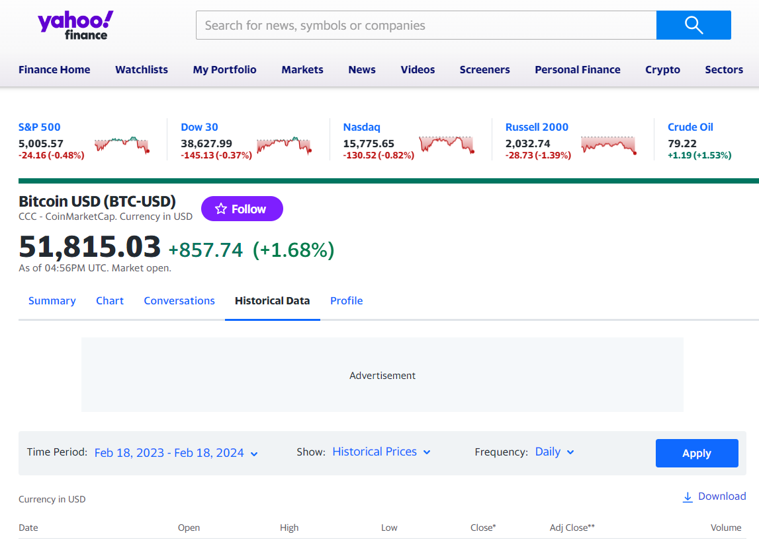
dataset
The Dataset we have collected from Yahoo! Finance.
Gathered Bitcoin Historical time series data among several Cryptocurrency
Features are Date, Open, High, Low, Close, Adj Close, Volume.

Slide 9
Linear regression For prediction
Linear regression helps in predicting cryptocurrency prices by modeling the relationship between historical data (such as price, volume, or market indicators) and future trends. It's easy to interpret, computationally efficient, and provides a baseline for more complex models. However, it may not capture the volatility and non-linear patterns typical in crypto markets.

Slide 10

Evaluation of models
For the measurement of the difference between actual an predicted value we used 5 type of magnitude
Measurement Scores
Mean Absolute Error (MAE) Mean Absolute Percentage Error (MAPE) Symmetric Mean Absolute Percentage Error (MAPE) Mean Square Error (MSE) Root Mean Square Error (RMSE) Mean Percentage Deviation (MPD) R-square(R2) Elapsed_time

Slide 11
Requirements (Cont…)
Hardware Requirements
1. Computer:
o CPU: Modern multi-core processor (e.g., Intel i5/i7 or AMD Ryzen 5/7)
o RAM: Minimum of 8 GB (16 GB recommended for larger datasets)
o Storage: SSD with at least 256 GB of available space (for faster performance and
ample space for data and models)
o GPU (optional but recommended for deep learning models): NVIDIA GPU with
CUDA support (e.g., GTX 1060 or higher) if using advanced ML models like MLP
or LSTM
2. Internet Connection:
o A stable internet connection for downloading datasets, libraries, and updates.

Slide 12
Requirements (Cont…)
Software Requirements
1. Operating System:
o Windows, macOS, or Linux (ensure compatibility with the required software)
2. Python Environment:
o Python: Version 3.7 or higher
o Package Manager: pip or conda (for managing Python packages)
3. Python Libraries:
o Data Manipulation: pandas
o Numerical Computing: numpy
o Machine Learning: scikit-learn, statsmodels, keras, xgboost (for additional
models)
o Web Framework: Flask (for app.py)
o Model Serialization: joblib or pickle (for saving and loading models)

Slide 13
Requirements (Cont…)
o Visualization: matplotlib, seaborn (optional, for data visualization)
o Others: requests, beautifulsoup4 (if scraping data or handling HTTP requests)
4. Development Tools:
o IDE/Text Editor: VSCode, PyCharm, or Jupyter Notebook (for developing and
testing code)
o Version Control: Git (optional, for version control and collaboration)
5. Web Browser:
o Modern browser (e.g., Google Chrome, Mozilla Firefox) to visualize and interact
with the web pages.
6. Database (optional, if needed for storing results):
o SQLite or another lightweight database if you plan to store historical predictions
or user inputs.

Slide 14
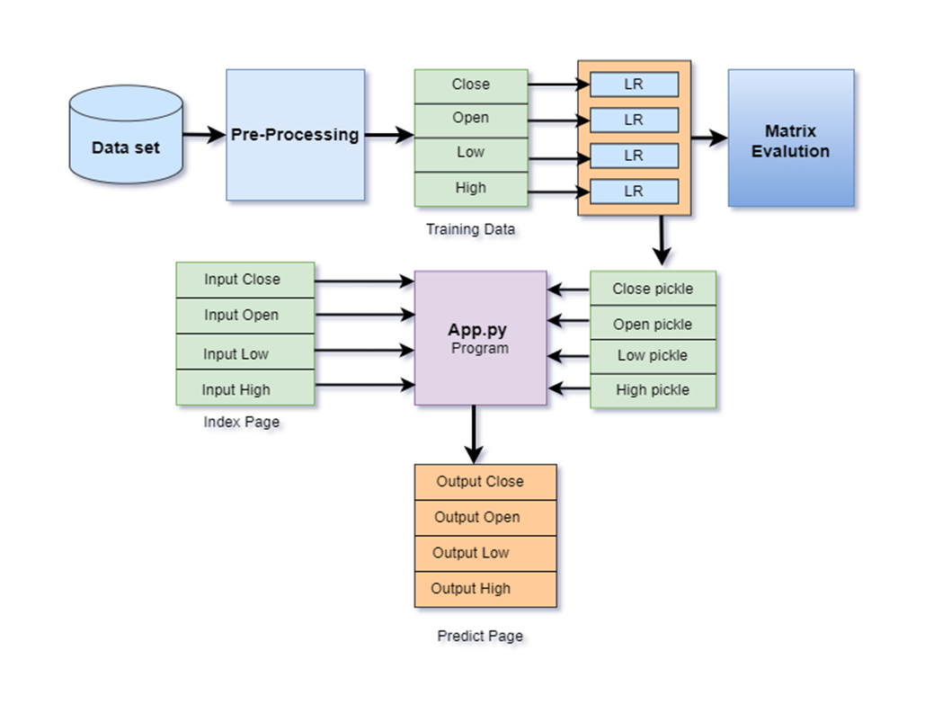
proposed system
Here we have briefly shown steps that we have perform
Figure: Proposed System

Slide 15

Implementation
Steps to follow:
Dataset & Preprocessing
Train-Test Split
Train models
Web Page design
Integration with app.py
Deployment

Slide 16

Dataset & Preprocessing
As dataset we have collected Bitcoin historical time series data from September 17, 2014 to July 31, 2024.
Dropped the Adj Column and Volume.
We set Date column as index for farther processing.
As the correlation of features are so high, we separated all as independent dataset
We reshaped all features within a similar range, Min-Max scaler is used.

Slide 17
Train-test split
Data Splitting | Time span
Train (80%) | September 17, 2014 to August 10, 2022
Test (20%) | August 11, 2022 to July 31, 2024

Slide 18
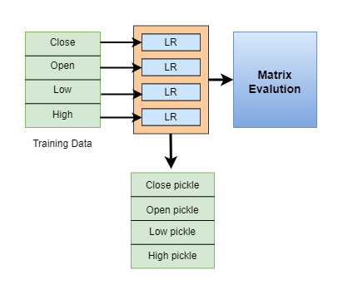
Train models
To forecast Bitcoin prices, Linear Regression, a widely-used and straightforward machine learning model, is trained to each of these four datasets. After training the models on these datasets, each trained model is saved as a pickle file. This results in four separate pickle files, each dedicated to predicting one of the price metrics: closing price, opening price, highest price, and lowest price.

Slide 19
Train models (Cont…) Measurement Scores
Measurement Scales | Close | High | Low | Open
Elapsed time | 0.002989 | 0.002997 | 0.002687 | 0.018995
MAE | 653.8944 | 556.6622 | 589.2676 | 656.0244
MAPE | 1.726743 | 1.497406 | 1.581253 | 1.73588
SMAPE | 1.72981 | 1.50332 | 1.57989 | 1.73889
MSE | 1149013 | 836404.4 | 952702.5 | 1149550
RMSE | 1071.92 | 914.5515 | 976.0648 | 1072.171
MPD | 0.90945 | 0.77422 | 0.81957 | 0.91241
R2 | 0.996164 | 0.99732 | 0.996645 | 0.996148

Slide 20
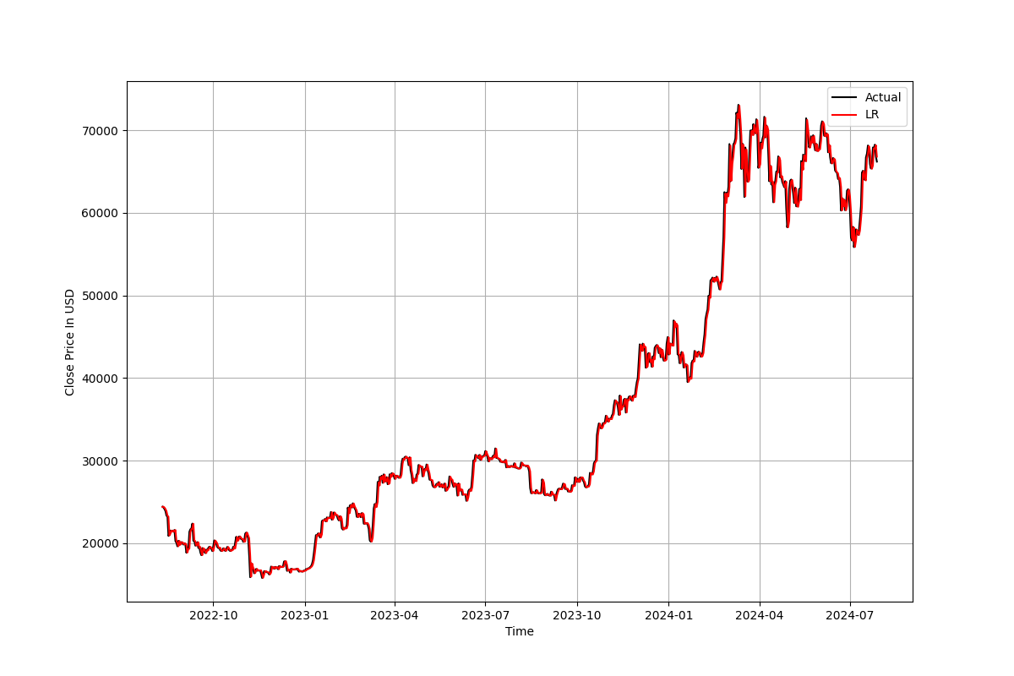

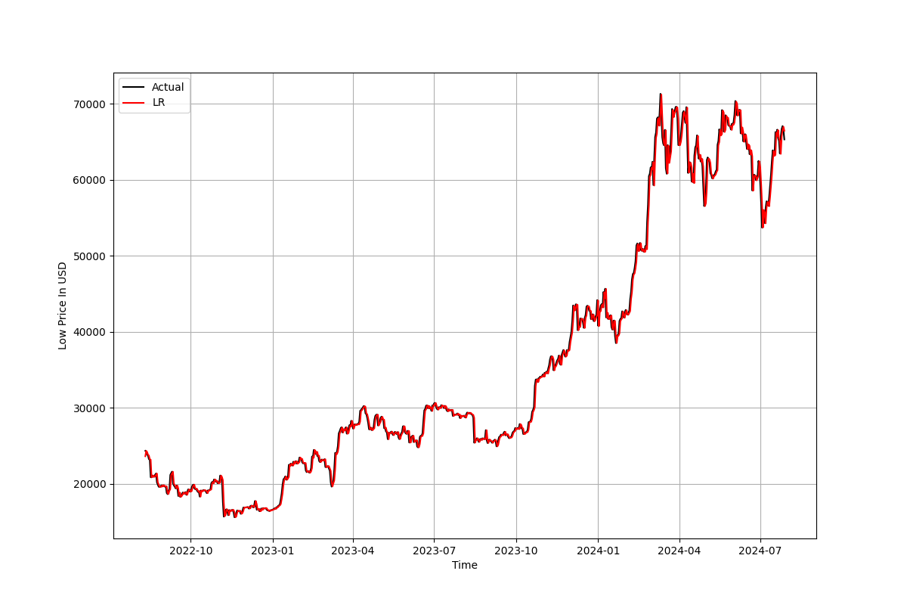
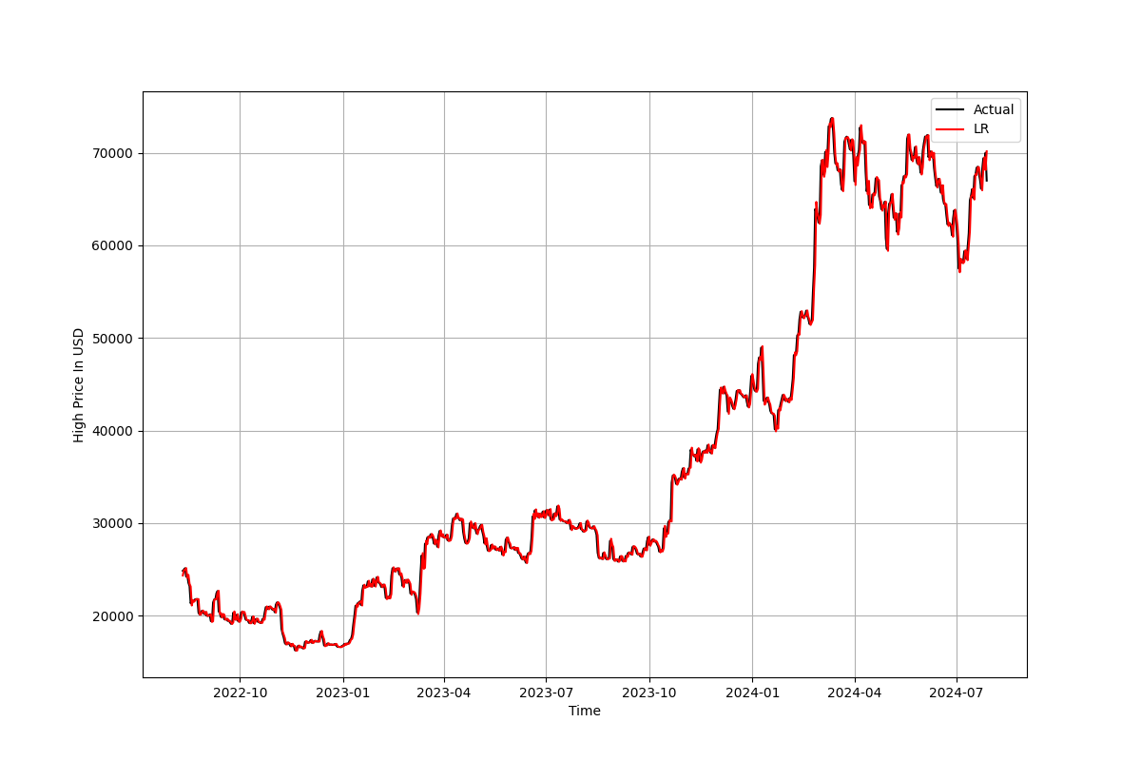
Train models (Cont…) Plotting
Actual vs Predicted Close price
Actual vs Predicted Open price
Actual vs Predicted High price
Actual vs Predicted Low price

Slide 21
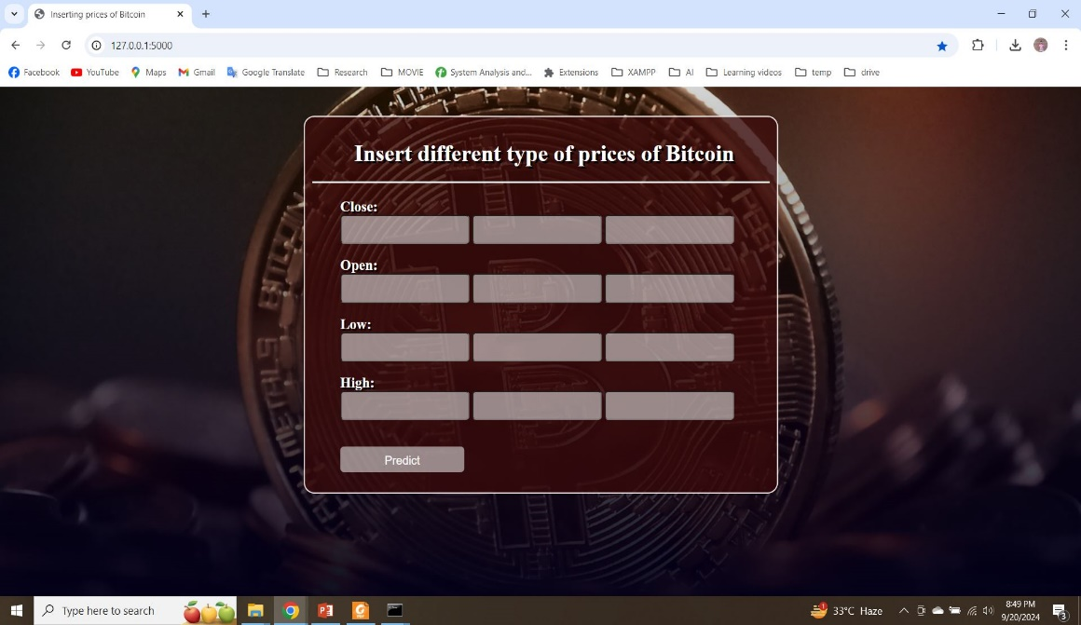
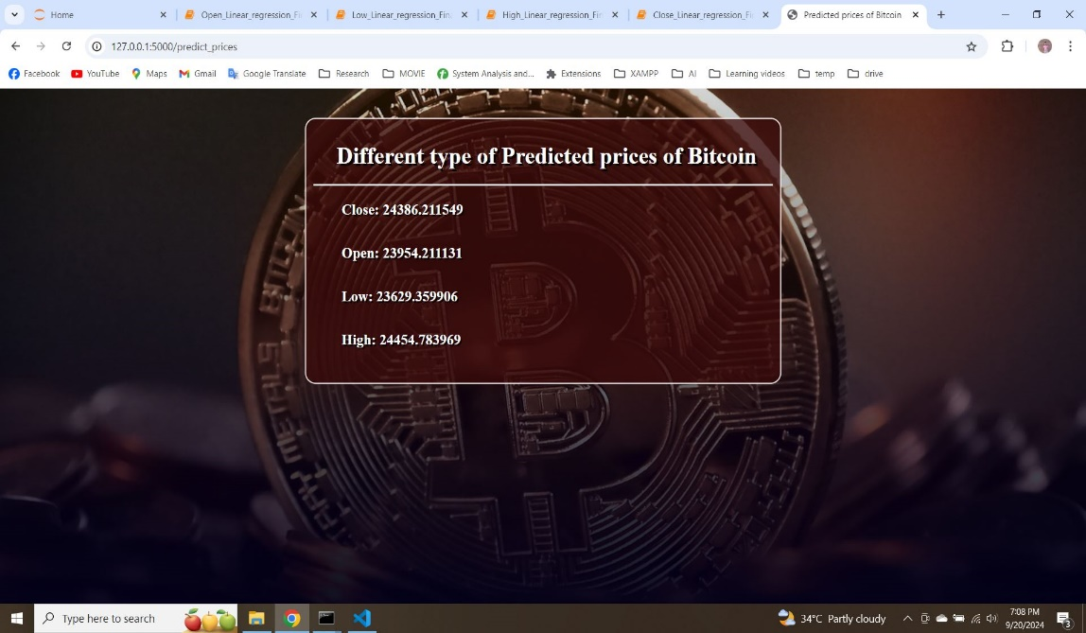
Web Page design
Index Page
Predict Page

Slide 22
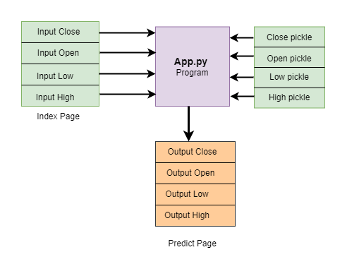
Integration with APP.py
At the core of the web application’s functionality is the Python script app.py, which acts as the backend logic that integrates the front-end web pages with the trained machine learning model.
The backend script manages the flow of data between the user interface and the models. It captures user inputs, passes them to the appropriate model, retrieves the predictions, and then sends this information to the results page for display.

Slide 23
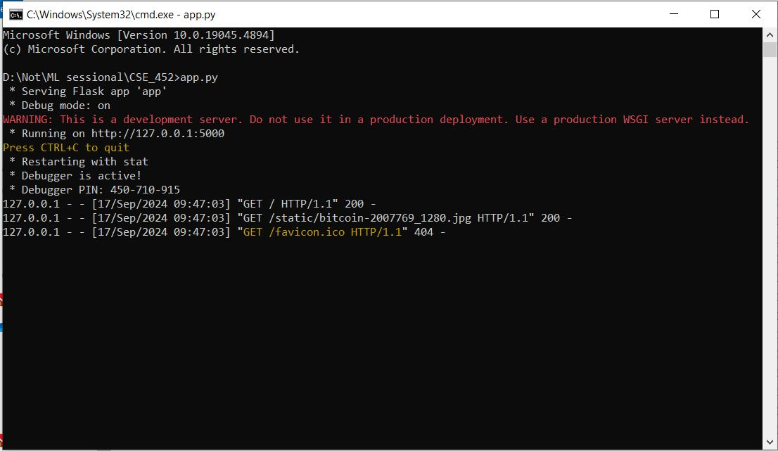
Deployment
The App.py file is the communicator or integrator of two web page named as index page and predict page App.py file gets the inputs from the form of index page .

Slide 24
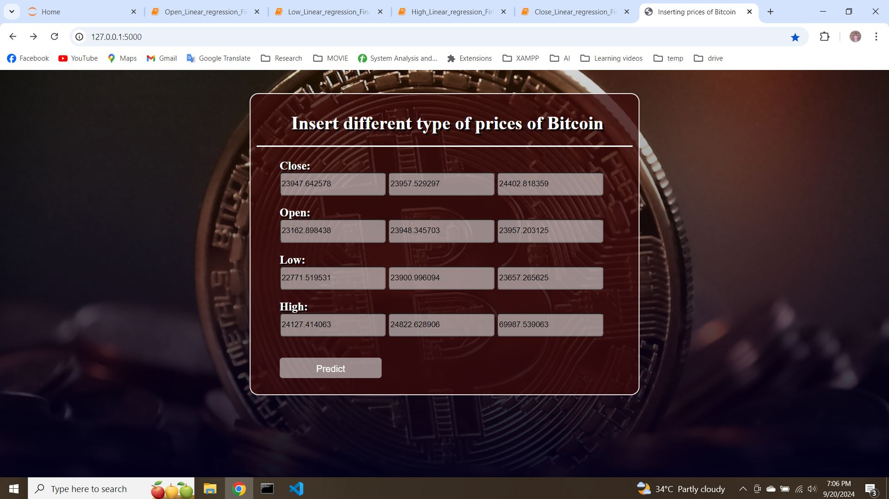
Deployment (Cont…)
The index web page on the browser which contains mainly a form to give input of Close, Open, High, Low prices

Slide 25
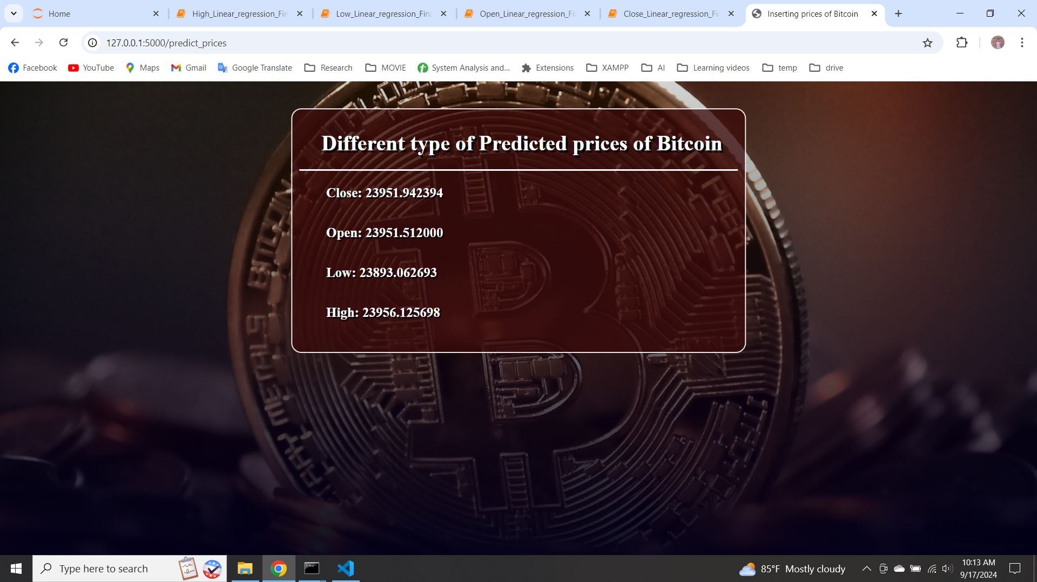
Deployment (Cont…)
The predict page show the results for the next day of Close, Open, High, Low.

Slide 26

Findings
User-Friendly Interface for Bitcoin Prices Forecasting.
Efficient Integration of Machine Learning Models.

Slide 27
Future enhancement
We would like to consider other cryptocurrencies (Ethereum, Ripple, Cardano) to conduct this experiment on.
Our next target is to apply the best efficient model.

Slide 28
Conclusion
This work on Cryptocurrency price prediction is highly usable for investors to enter into or exit from the market. It enables them to make more informed decision about the future of the digital asset market.

Slide 29
reference
[1] Ali, M., & Shatabda, S. (2020, November). A data selection methodology to train linear regression model to predict bitcoin price. In 2020 2nd International Conference on AdvancedInformation and Communication Technology (ICAICT) (pp. 330-335). IEEE.
[2] Uras, N., Marchesi, L., Marchesi, M., & Tonelli, R. (2020). Forecasting Bitcoin closing price series using linear regression and neural networks models. PeerJ Computer Science, 6, e279.
[3] Saheed, Y. K., Ayobami, R. M., & Orje-Ishegh, T. (2022). A comparative study of regression analysis for modelling and prediction of bitcoin price. In Blockchain Applications in the Smart Era (pp. 187-209). Cham: Springer International Publishing.
[4] Gupta, A., & Nain, H. (2021). Bitcoin price prediction using time series analysis and machine learning techniques. In Machine Learning for Predictive Analysis: Proceedings of ICTIS2020 (pp. 551-560). Springer Singapore.34 [10] Karasu, S., Altan, A., Saraç, Z., & Hacioğlu, R. (2018, May). Prediction of Bitcoin prices with machine learning methods using time series data. In 2018 26th signal processing and communications applications conference (SIU) (pp. 1-4). IEEE.
[5] Phaladisailoed, T., & Numnonda, T. (2018, July). Machine learning models comparison for bitcoin price prediction. In 2018 10th international conference on information technology and electrical engineering (ICITEE) (pp. 506-511). IEEE.

Slide 30
Thank you

